Slide 1


LASAGNE
digitaL frAmework for SmArt Grid and reNewable Energies
ERA-NET 108767
SFOE 810008657
WP3: Coordination model and intelligent digital twins
Giovanna Di Marzo Serugendo
Philippe Glass

Slide 2
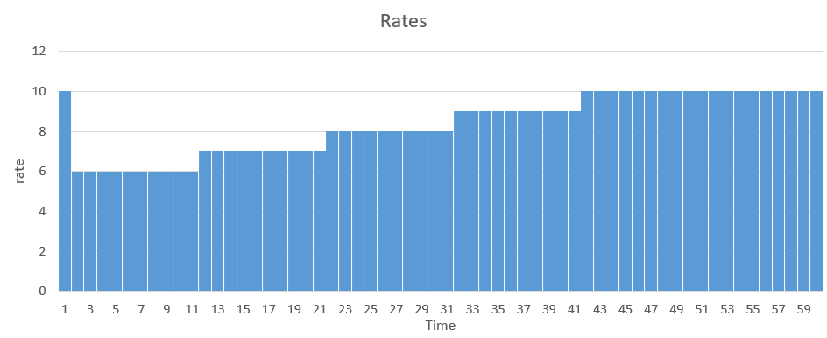
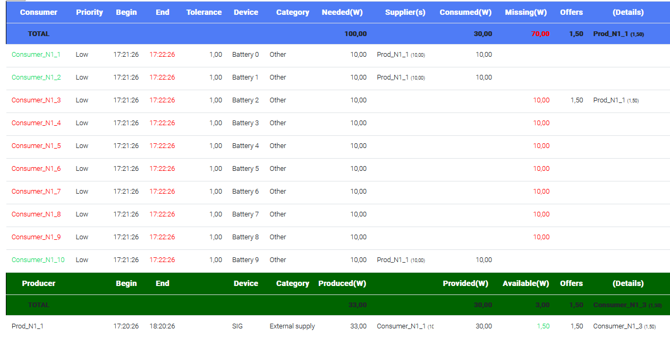
Simulation of the scenario “tragedy of the commons”
cheapest period for all consumers
Monthly meeting November 22, 2022
Rates of electricity set by a producer :
Results :
10 demands at the same time (10 x 10 Watts) :
only 3/10 can be satisfied
33 Watts produced

Slide 3
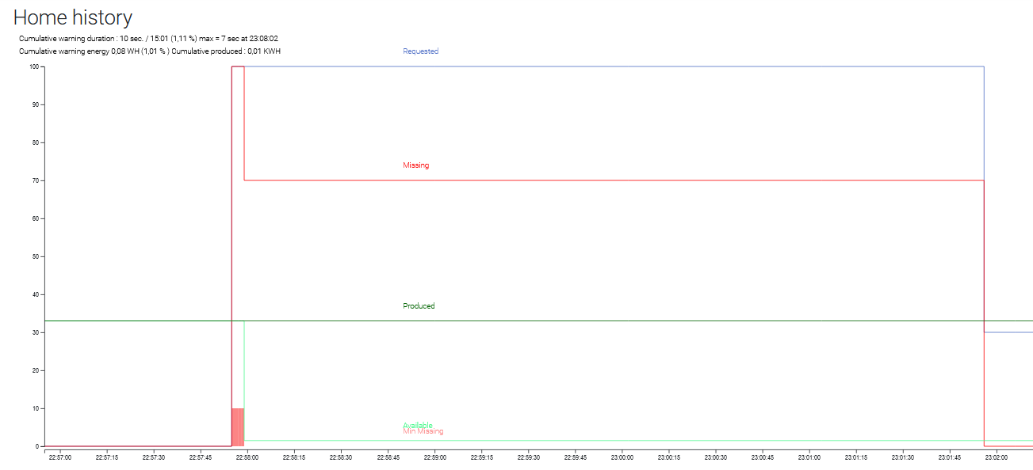
Simulation of the scenario “tragedy of the commons”
Monthly meeting November 22, 2022
History view
demand
missing
Demands period: only 30% of demands met

Slide 4
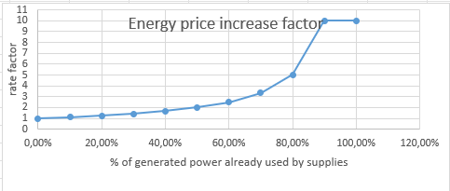
Alternative scenario of “tragedy of the commons”
Monthly meeting November 22, 2022
Producers apply a dynamic pricing based on demand
Rise factor depending on the producer availability
Rise factor updated in real time
Unsatisfied consumers refresh rate updates and reschedule their demands

Slide 5
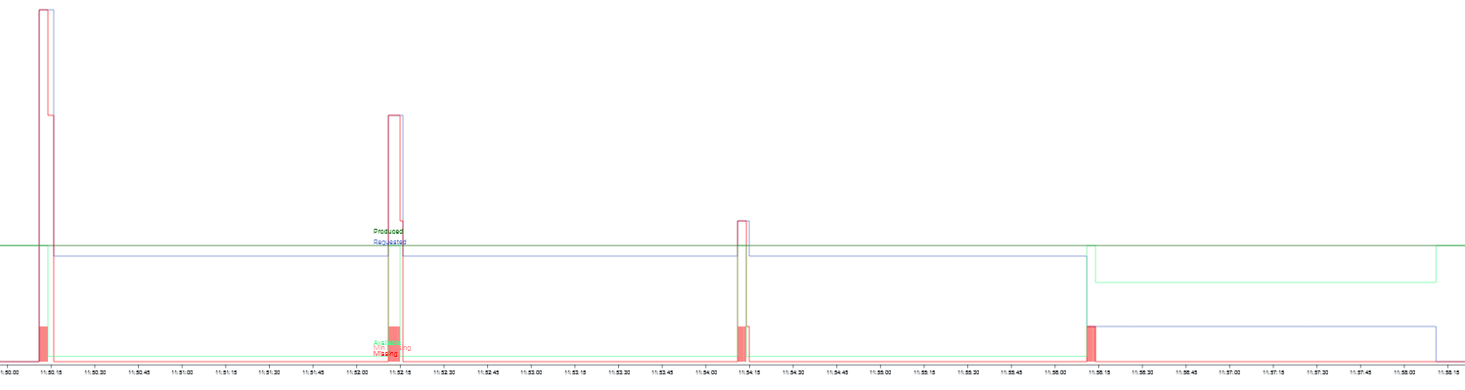
Alternative scenario of “tragedy of the commons” : using of a pricing policy
Monthly meeting November 22, 2022
=> Result :
(history view)
demand
Period 1 : consumer 1,2,10
Period 2 : consumer 3,4,5
Period 3 : consumer 6,7,8
Period 4 : consumer 9
Demands staggered in 4 period => 100% demands met
problem addressed if enough energy can be distributed in a reasonable time
partial supply is not possible

Slide 6
Next action items
Monthly meeting November 22, 2022
Enhance requests flexibility : staggering of energy demand over time
(to adapt to energy availability and cost constraint)
Design a producer policy to meet peak demand.
Calculation of forecasted needs using all received demands and prediction
Dynamic rate adjusting according to the demand (set by market rule or by the agent itself)
Response to all demands
by reducing supplied wattages
by prioritizing pending demands
Introduce negotiation between producers and consumers, e.g. auction behavior , peer to peer negotiation
(optional behavior)
Improve node predictions by using federated learning applied in a decentralized manner, exploiting the coordination platform

Slide 7
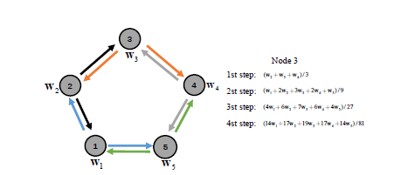
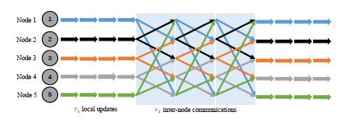
Study of “Decentralized Federated Learning”
Monthly meeting November 22, 2022
Use of machine learning at each node level
Fully decentralized
Exchange of model data between nodes
Aggregation of model weights at each node (progressive aggregation)
Balance by internode communications and local updates.
- τ1 cycles of local computation
- τ2 cycles of inter-node communications
Wei Liu, Li Chen, and Wenyi Zhang : Decentralized Federated Learning: Balancing
Communication and Computing Costs
Advantages :
- Ensure a good speed of convergence
- Reduce the network traffic between nodes
- Do not share confidential data

Slide 8
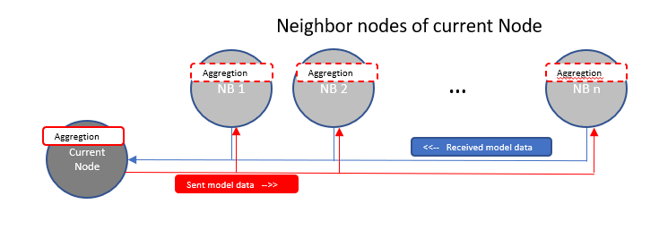
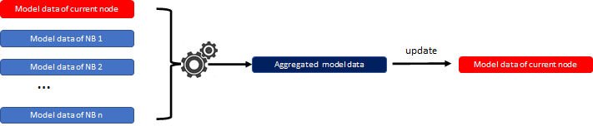
Implementation of Decentralized FL in the platform of coordination
Monthly meeting November 22, 2022
Use of “propagation” eco-law at a node level
Design, implementation and use of “aggregation” eco-law at a node level (customized)
Use of machine learning at a node level
Different kind of models can be used (Markov chains, LSTM Neural network)
Notes:
Serait-il possible de copierr le dession

